Slide 1
Spritzer BLE design & architecture (draft)
China Software Center

Slide 2
Contents
Sprizter BLE framework
Sprizter Serialization Codec
Sprizter Serialization Transport&PHY Layer
Sequence
Custom Profile

Slide 3
Contents
Sprizter BLE framework
Sprizter Serialization Codec
Sprizter Serialization Transport&PHY Layer
Sequence
Custom Profile

Slide 4
Sprizter BLE framework
Spritzer
Nordic
Application
Connectivity firmware
(while loop)
API resp
Legend
API call
event
SD event
Vendor provided
BLE
Stub
BLE Wrapper
SD call
SD event
CSC
implement
SD resp
SD event
SoftDevice API
Serialization
Codec
Sd call
SoftDevice API
SoftDevice
sync call
Serialization
Codec
Sd resp
async call
Packet
return
Packet
Packet
Packet
Serialization
Transport
Serialization
Transport
Packet
Packet
Packet
Packet
Serialization PHY
Serialization PHY
TX
RX
RX
TX
Spritzer
SDK
Hardware PHY Driver
UART
Hardware PHY Driver

Slide 5
Sprizter BLE framework -- Tasks
BLE_MainTask
This is the main Task of BLE application. It belongs to application. It includes application layer and BLE stub and UART. It handles BLE command packet send.
Priority:5 LOW(※)
BLE_RcvEvtTask
This is BLE event receive Task.it belongs to BLE framework.it pulls BLE event from message queue and calls Event callback function.
Priority:3 MIDDLE
BLE_RcvUartPollingTask
This is UART receive polling Task.This task receives data from UART port. It is a workaround, because the UART receive callback don’t work well right now.
Priority:2 HIGH
※Priority:BLE_MainTask < BLE_RcvEvtTask < BLE_RcvUartPollingTask
Actual spritzer priority Value we need you suggestion

Slide 6
Sprizter BLE framework -- Tasks
BLE_MainTask
BLE event callback
Application
BLE_RcvEvt Task
BLE_RcvUartPollingTask
SEND
BLE CMD
RECEIVE
EVENT
BLE receive
event Task
BLE event
Queue
UART
driver
workaround
Uart Receive polling Task

Slide 7
Contents
Sprizter BLE framework
Sprizter Serialization Codec
Sprizter Serialization Transport&PHY Layer
Sequence
Custom Profile

Slide 8
Packet Encoding Format
Packet Type
Packet
Vender Provided
Codec packet Format
1 byte
0x00: Command
0x01: Command Response
0x02: DTM Command
0x03: DTM Command Response
Variable length
Example: SoftDevice API: BLE_GapSetAddress
Packet Type:
0x00
Packet
1 byte
10bytes
Operation code
Address cycle mode
Field present
Address
1 byte
1 byte
1 byte
7 bytes
Type
Address
1 byte
6 bytes

Slide 9
Commands and responses
sync call
Spritzer
Nordic Codec
Nordic SoftDevice
return
Command
execution
Command /
DTM command
Function call
Wait
Vender Provided
Commands &
Responses
SoftDevice response
Command Response /
DTM command response

Slide 10
Events
Spritzer
Nordic Codec
Nordic SoftDevice
Async call
Event triggered
Vender Provided
Event
SoftDevice event
Event encode
Event

Slide 11
Transmitting a packet
Serialization Transport layer
Legend
Vendor provided
CSC implement
ser_phy_tx_pkt_send
(const uint8_t* p_buffer, uint16_t num_of_bytes)
SER_PHY_EVT_TX_PKT_SENT
sync call
Serialization PHY Layer

Slide 12
Sequence – Scanning -2
Spritzer
Module
Application
Wrapper
SoftDevice API
SoftDevice
Peripheral
Nordic
nRF51
[Application stops scanning]
BLE_GapStopScan(…)
Peripheral role
device
sd_ble_gap_scan_stop(…)
Softdevice API
serialization
sync call
async call
return
[Scanning timeout]
Softdevice API
serialization
serialization
BLE_GAP_EVT_TIMEOUT
Adv packet on PHY channel
BLE_GAP_EVENT_TIMEOUT

Slide 13
Custom Profile
Legend
Vendor provided
(Sample) Application
Sample Data Profile
CSC implement
Stub
Sample Data Service
BLE stub
Led Characteristic
Generated
Attribute DB
GATT
based
Profile
Spritzer
Custom
Profile
Button Characteristic
Spritzer SDK
GATT
based
Profile
UART
driver
UART
driver
Bluetooth
Core Stack
UART
Hardware
Hardware
Spritzer Custom Profile: Sample Data Profile

Slide 14
Sample Data Service Structure
led Characteristic
Value
Type
Properties
Permission
led
Uint8
Read
Write
Read
Write
SDS Service
button Characteristic
Value
Type
Properties
Permission
button
Uint8
Read
Notify
Read

Slide 15
Sample Data Service Structure --UUID
Sample Data Service
BASE UUID
0xFFEE0000-0011-2233-4455-66778899AABB
UUID alias
Service: 0x0000
Led characteristic: 0x0001
button characteristic: 0x0002
Description | UUID | Properties
SDS service | 0xFFEE0000-0011-2233-4455-66778899AABB
led characteristic | 0xFFEE0001-0011-2233-4455-66778899AABB | Read,Write
button characteristic | 0xFFEE0002-0011-2233-4455-66778899AABB | Read,Notify

Slide 16
Read characteristic sequence
Spritzer
Module
Application
GPIO driver
Wrapper
Nordic
Central
Nordic
nRF51
Attribute
Table
Central role
device
Read Procedure
sync call
Application
Don’t need to handle read characteristic directly
Without Authorization
async call
return
serialization
PHY channel

Slide 17
Notify sequence
Spritzer
Module
Application
GPIO driver
Wrapper
Nordic
Central
Nordic
nRF51
BUTTON_CHANGE
Central role
device
BLE_GattsHandleValueNfyInd (…)
sync call
serialization
async call
return
serialization
Notify Procedure
PHY channel

Slide 18
GATT client database discovery
Spritzer
Module
Application
Wrapper
SoftDevice API
SoftDevice
Peripheral
Nordic
nRF51
BLE_GattcStartDbDiscovery(…)
Softdevice API
serialization
sd_ble_gattc_primary_services_discover(…)
[LOOP]
Peripheral role
device
sync call
SERVICE_RSP
async call
sd_ble_gattc_characteristics_discover (…)
Softdevice API
serialization
return
serialization
CHARACTERISITC_RSP
Adv packet on PHY channel
sd_ble_gattc_descriptors_discover(…)
Softdevice API
serialization
DESCRIPTOR_RSP
BLE_GATTC_EVENT_DBDISCOVERY

Slide 19
Msg queue
Share mem
semaphore
Write characteristic sequence
Spritzer
Module
AT&T
Application
GPIO driver
Wrapper
Central
Linux IPC
Unix ipc
Syetem V IPC
BLE_CommonSetBleEvtCallback(…)
Nordic
nRF51
Write Procedure
Central role
device
BSD
sync call
serialization
Socket IPC
async call
BLE_GATTS_EVENT_WRITE
return
Posix IPC
serialization
sigaction
BLE_WriteLed(…)
PHY channel
PIPE
Named pipe
FIFO
signal
IPCS cmd
userspace
Kernel sp

Slide 20
Iuniverse begin
Liberary

Slide 21
Msg queue
Share mem
semaphore
AT&T
Linux IPC
Unix ipc
Syetem V IPC
BSD
Socket IPC
Posix IPC
sigaction
PIPE
Named pipe
FIFO
signal
IPCS cmd

Slide 22
Bluetooth LE single Mode
Bluetooth
BR/EDR
Bluetooth
Dual Mode
IPCS cmd
General
Attribute
Profile
Serial Port
Profile
IPCS cmd
Serial Port
Profile
General
Attribute
Profile
Rfcomm
Protocols
Attribute
Protocol
Rfcomm
Protocols
Attribute
Protocol
L2CAP
L2CAP
L2CAP
Link
Manager
Link
Manager
Link
layer
Link
layer
Basic Rate
RF
Low energy
RF
Basic Rate +Low energy
RF
sigaction
PIPE
Named pipe
FIFO
signal

Slide 23
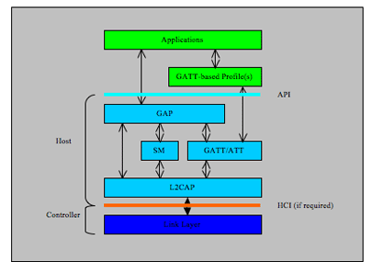
Bluetooth LE single Mode
General
Attribute
Profile
Attribute
Protocol
L2CAP
Link
layer
Low energy
RF
sigaction
PIPE
Named pipe
FIFO
signal

Slide 24
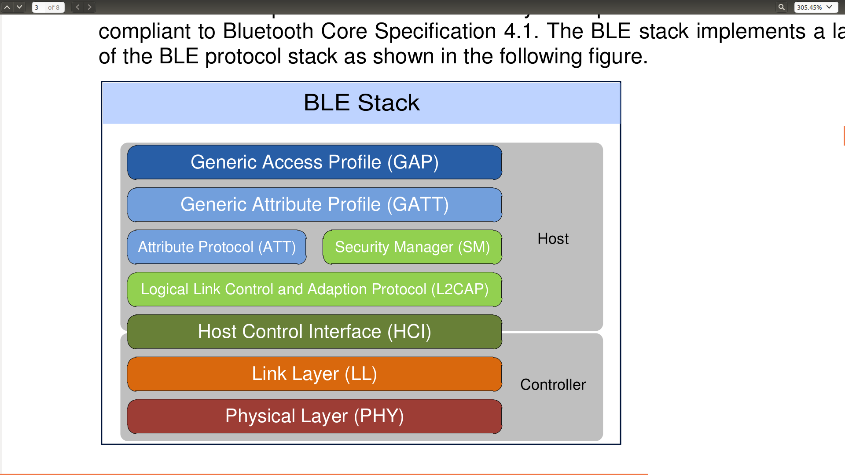

Slide 25
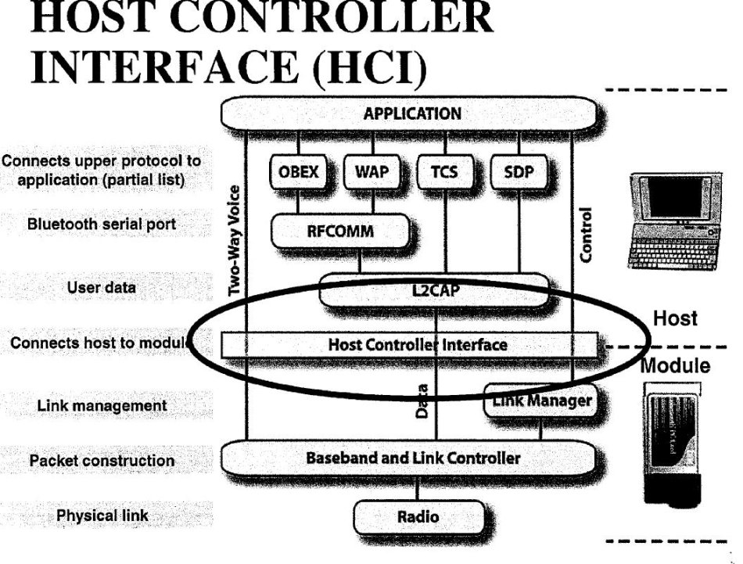
BlueZ

Slide 26
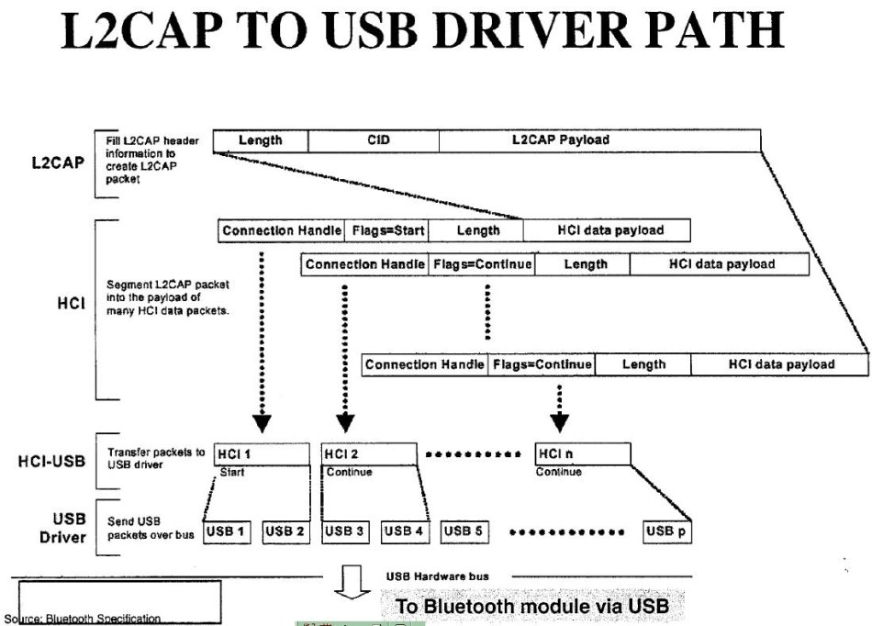
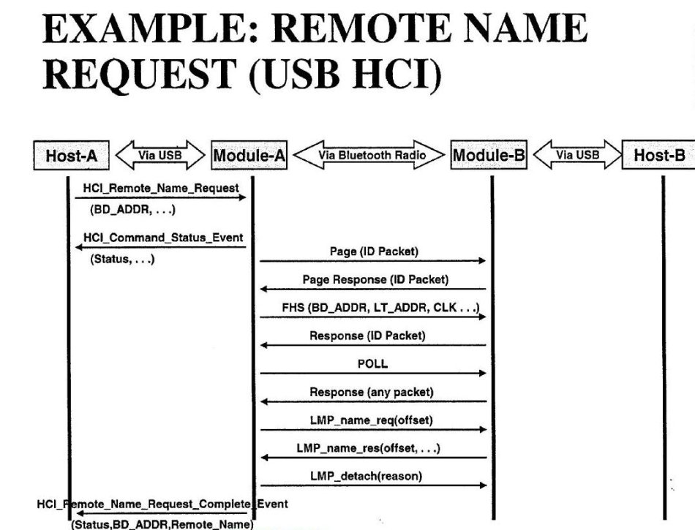
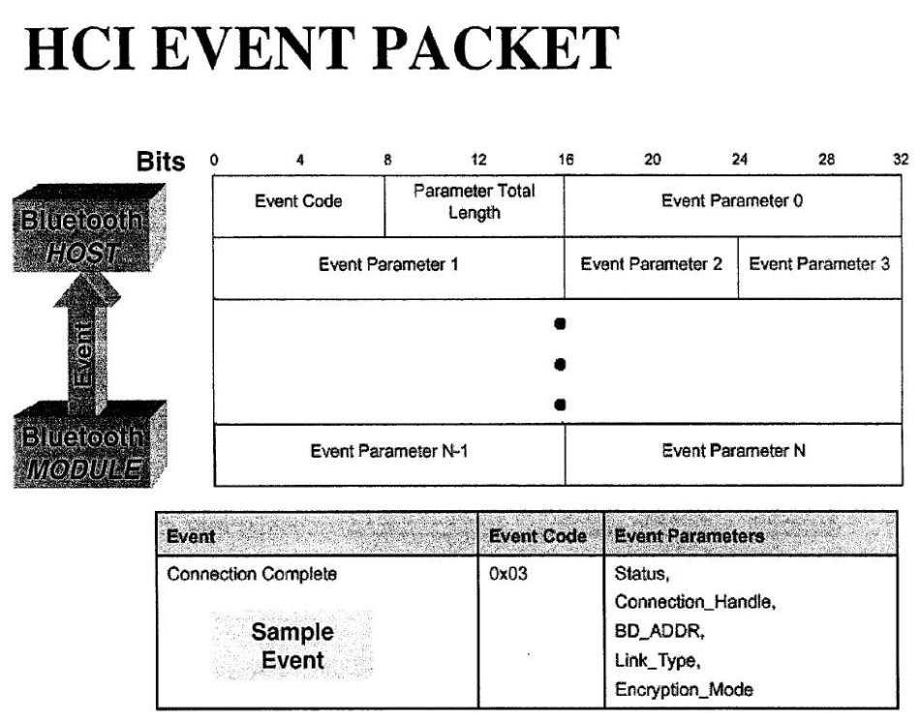
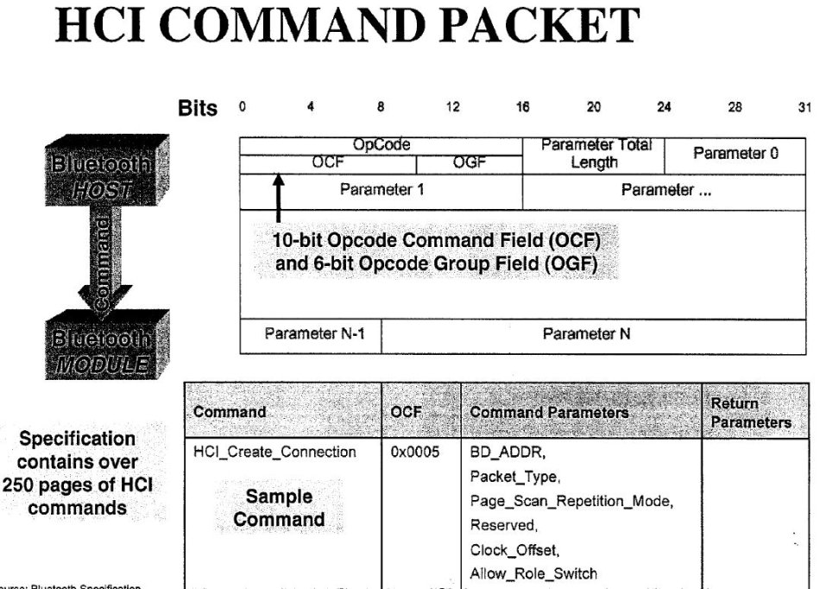
BlueZ

Slide 27
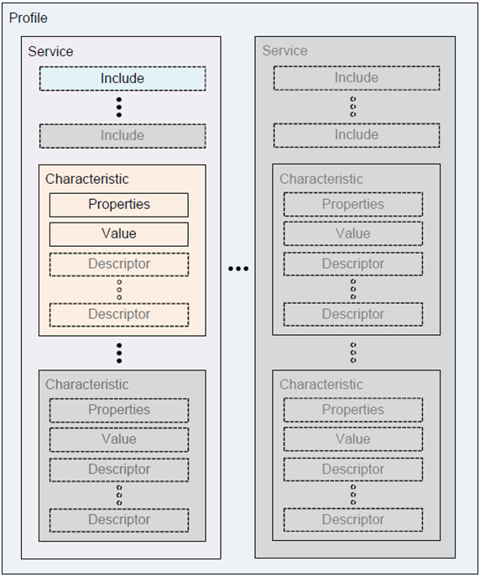
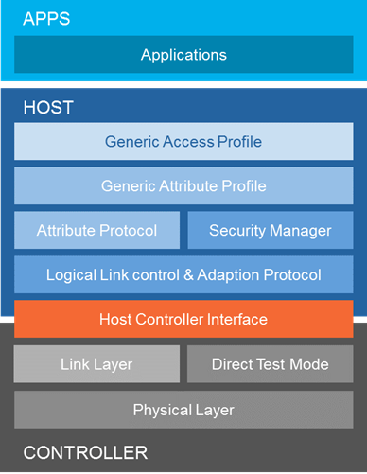
GATT profile hierarchy

Slide 28
User space
uboot
Hardware
task
Architecture
ARM
Opcode
Ahb
Apb
Find
Grep
Bash
Sed
Awk
Vm
Vim
Git disttribute
Make
Gdb
Compiler
Ld
google
kernel
Device tree
scheduler
Parser for binary opcode
ram
vfs
text
cpu
Data bus
stack
fork
mmu
heap
exec
Ro data
Usb contoller
Fifo
List
Stack
Queue
Tree
Hash
ROM
elf
bss
algorithm
Date STR
PL

Slide 29
Driver module
app
sys_call
bus
driver
vfs
device
Probe
remove
File
Inode
Dentry
bus
Char
Register
Add
Start
fops
device
driver

Slide 30
object
language
Paper pencil
obit
computer
tools
UML ppt visio
Vim find grep
Vim cscope
sun
heat
Serialized large packet sent from Host
light
Receive buffer
tools
A-Z aphabet
english
A e I o u
Find law
Maths law
packet
man
Symblic universe
Neoton calculation
maths
DNA AGCT
← number and sharp
Geo axis y z.
eye
Physics electron
PL
Asm c
ear
Neuron brain
New cortex
Con sci ous
lisp
Cirriut
algorithm
Peni virgin
UML
iuniverse →j
dna
geometry
protein
Pre serve
Pre servation
Sur vivid machine
Scire : to know
Sci ence
build
23 a chromesomes
23 b chromesomes

Slide 31
objects
object
obit
sun
heat
earth
computer
light
man
eye
Neuron brain
New cortex
Con sci ous
ear
Peni virgin
dna
time

Slide 32
body
man
iuniverse →j
eye
Neuron brain
New cortex
Con sci ous
ear
Peni virgin
dna
Pre serve
Pre servation
Sur vivid machine
protein
build
23 a chromesomes
23 b chromesomes

Slide 33
brain
language
Paper pencil
tools
UML ppt visio
Vim find grep
Vim cscope
tools
A-Z aphabet
english
A e I o u
Find law
Maths law
packet
maths
Neoton calculation
DNA AGCT
Neuron brain
New cortex
Con sci ous
Symblic universe
← number and sharp
Geo axis y z.
Physics electron
PL
Asm c
energy
consous
lisp
Cirriut
algorithm
memory
UML
athletic
dream
calculate
see
geometry
Scire : to know
Sci ence

Slide 34
AP storage: realize Flash-less operation
Marvell AP
Spritzer
Problem
ActivityLog is designed on the assumption that it will store log data into SPI-Flash connected to Spritzer
System which has AP like Nigel, has storage on AP side as well, so we want to integrate into one device.
Reduce number of parts, reduce PCB size.
Measure
Develop AP Storage Service
Works cooperatively among AP and Spritzer
From Software on Spritzer, it looks like as if virtual Flash is connected.
⇒ Activity Log can work without (almost) any modification
Activity Log
(ISD)
Host I/F
(SPI)
Flash Manager
(DSBG)
Save log data
Flash
Flash
Spritzer Standalone system
Marvell AP
Spritzer
Activity Log
(ISD)
Host I/F
(SPI)
AP Storage Service
AP Storage
I/F
(BSD)
(BSD)
Flash
Provides compatible I/F
with Flash Manager
1
Notes:
まず、こちらは、Spritzer の FLASH レス化の課題です。
Nigel は、ユーザーの行動認識やGPS測位の結果をロギングする Spritzer の機能を使用しますが、これは、Activity Log という ISD 開発のソフトウェアによって実現されます。
しかし、この Activity Log は Spritzer 単独でも動作できるようにという観点から、Spritzer に接続されたフラッシュにデータを蓄える前提で設計されています。
今回のNigelのように、横にAP、Application Processorが接続されている場合、AP用にもストレージが別途あるため、部品点数や基板面積の面で、できるだけ１つにまとめたいという要望があります。
この課題に対する対策として、今回、私は AP Storage Service という機能を新規に設計しました。この AP Storage Service は、AP と Spritzer の双方で協調して動作することで、Spritzer 内のソフトウェアに対して、あたかも仮想的なFlash が接続されているかのように見せる機能です。Activity Log は Spritzer に接続された Flash を読み書きしているつもりで動作しても、この機能によって、実際の読み書きはAP側に接続された Flash で行われるようになります。これにより、Activity Log は殆ど無修正のままこの問題に対応することが可能となりました。
この AP Storage Service 機能は、アーキテクチャ設計までは完了しており、今後、BSDで開発を行っていく予定となっております。
1

Slide 35
One important notice / change required to support deserialize
As for SFClientGnss_DeserializeCommand(), actually it splits the large packet in-place:
it overwrite the pointer field in small packet part of the large packet.
I assume that we just pass the receive buffer in HostIF
to DeserializeCommand().
This buffer should not be overwritten / modified by HostIF
while GNSS uses (refers) large data portion.
When HostIF receives corresponding command callback,
it means GNSS finished using (referring) the large data.
I think that, in current HostIF (sensor handler) design,
it will soon release the receive buffer to accept next
command after sending the packet to Sensor Framework,
buf as for GNSS command which requires deserialize
(i.e. SF_COMMAND_GNSS_SET_ALMANAC and
SF_COMMAND_GNSS_SET_EPHEMERIS as of the moment),
we should not release the buffer until we receive
corresponding command result callback.
it is okay we cannot receive next command until
we get these command result callback
Receive buffer
Serialized large packet sent from Host
DeserializeCommand()
Receive buffer
large data
to be passed to
Sensor client
small
packet
just modify pointer field in-place →
M0P
GPS
Sensor
Framework
Sensor
Framework
Receive buffer
packet
packet
large data
referred from
Sensor client
HostIF
GNSS
Sensor Client
← We should keep this buffer
while GNSS referring it.
1

Slide 36
Objects dir
/nature
chemistry
cell
Atom
Time
Space
Gravity
Ralativity
Light
force
bus
computer
Hardware
softeware
Os
Algrithm
Data St
PL
body
myself
exec
neuron
brain
english
Manths xyfz

Slide 37


HW Components related to HostIF
There are two HW components related to Host SW
Sensor Control Unit (SCU)
Collect sensor data and stores it to FIFO
Host Interface Controller (Host IFC)
HW component mainly communicates with Host
CPU
SRAM
SCU
Host IFC
Seq
Seq
RAM
Arbiter
SPI/I2C
FIFO
SPI/I2C
Spritzer
Sensor
Sensor
Host
Host
SPI/I2C
1
Notes:
1

Slide 38
computer
object
language
Paper pencil
obit
tools
UML ppt visio
Serialized large packet sent from Host
Vim find grep
Vim cscope
Neoton calculation
sun
heat
light
Receive buffer
← number and sharp
Geo axis y z.
Cirriut
PL
maths
Find law
Physics electron
Maths law
geometry
man
Symblic universe
eye
law
A fire upon deep
Neuron brain
ear
The grand design
What is life ? Quota schdingor
Penis virgin
iuniverse →j
dna
Enst kaser renlun

Slide 39
CPU
SRAM
3G
socket
bluetooth
wifi
blueZ
Seq
RAM
tcp
PPP
Arbiter
Over uart
SPI/I2C
FIFO
Usb tty
ethenet
SPI/I2C
HCI
Sensor
Host
Host
SPI/I2C
1
Notes:
1

Slide 40
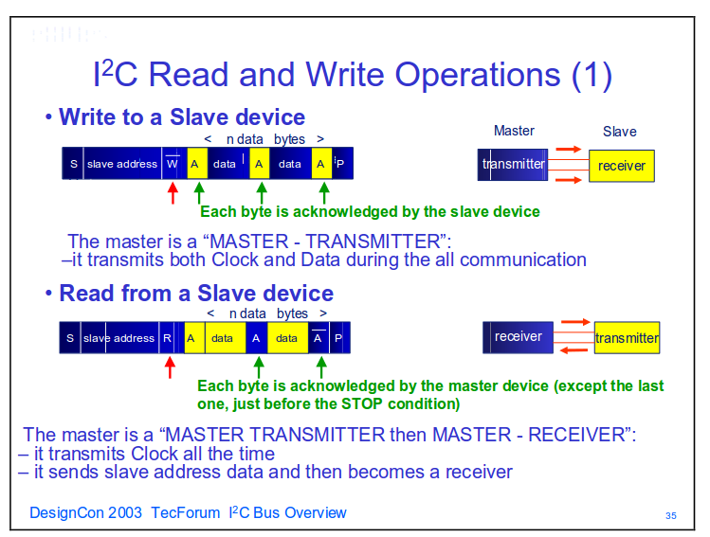
iic
1
Notes:
1

Slide 41
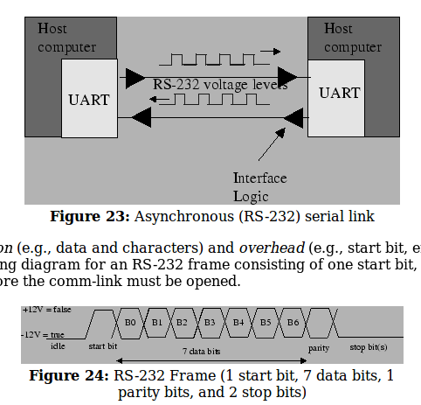
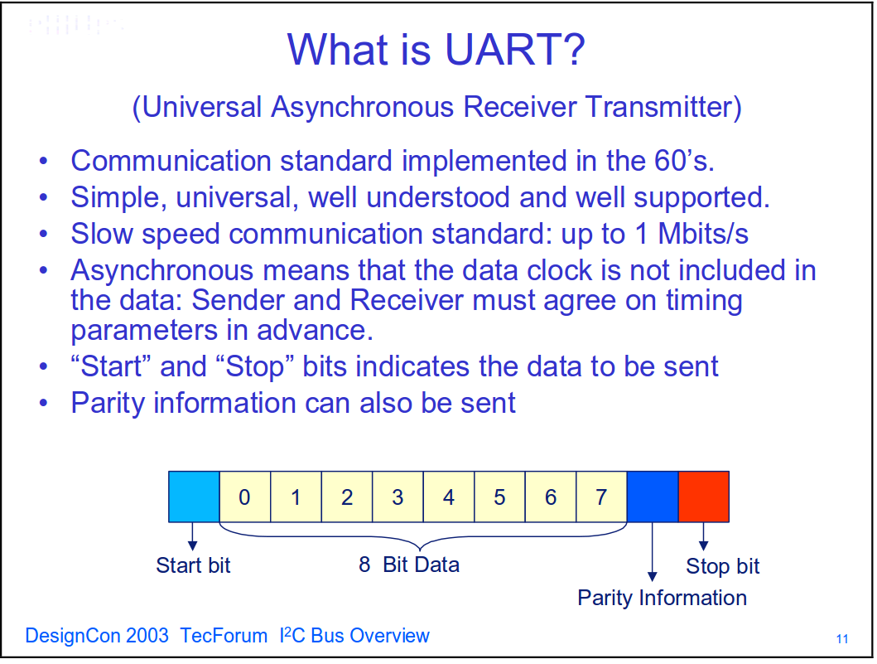
uart
1
Notes:
1

Slide 42
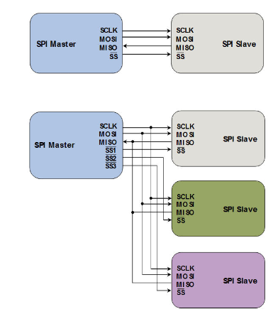
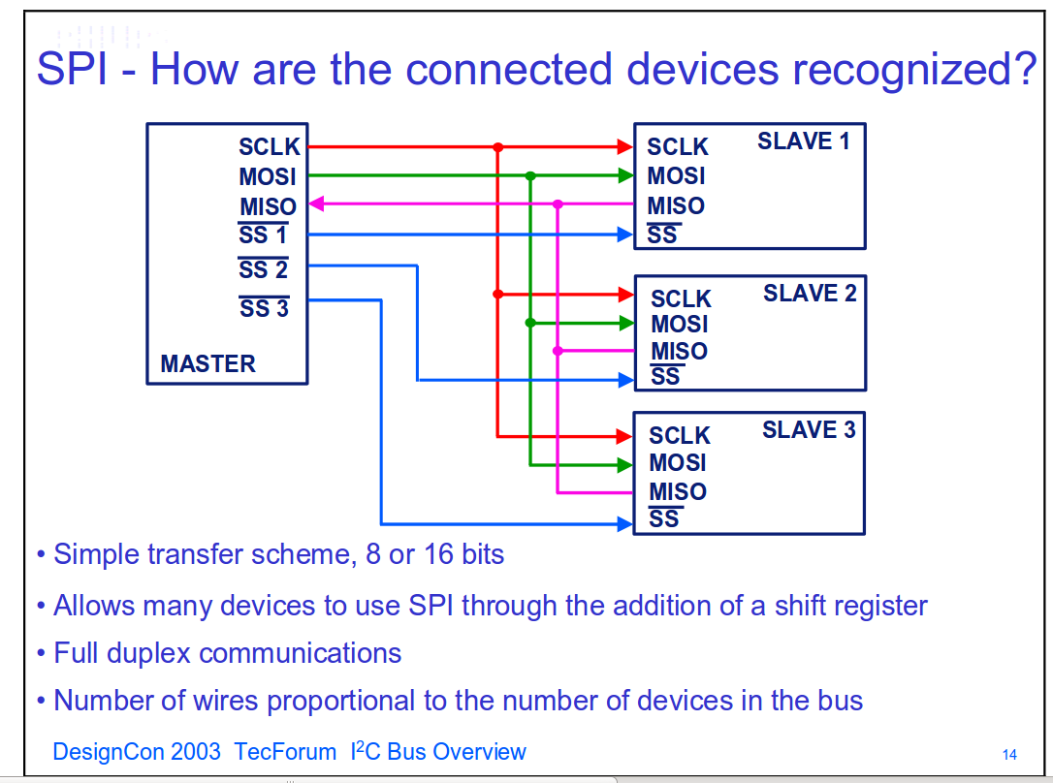
spi
1
Notes:
1

Slide 43
USB接口的数据线采用差分布线的方式，以保证信号传输的质量，抑制干扰。通常认为信号在传输时采用3种方式：单点对单点、差分模式和共模模式。相比于单点对单点模式，差分信号有着明显的不足，就是它需要两根走线，如果PCB上信号都采用差分布线的方式，可以想象电路设计者会陷入绝境。但是差分信号又有着其不可替代的优点[3]：
（1）差分信号在低电平应用时非常有效。因为如果一个信号的电平非常低，那么这个信号就比较容易受到其他信号的干扰，而差分信号使这个信号的电平加倍。
（2）由于差分信号是电平相同而且反向的两根信号，不需要参考平面作为信号回路，这样就不需要地平面或电源平面的连续性和完整性。
（3）如果两根信号都存在噪声干扰，就可以通过相减来抵消噪声，因此差分信号对信号干扰有着天然的免疫力。
（4）相对于单点信号，差分信号的开关时序会比较精确，因为单点信号受到噪声干扰后时序或占空比通常会发生变化。
spi
1
Notes:
1

Slide 44
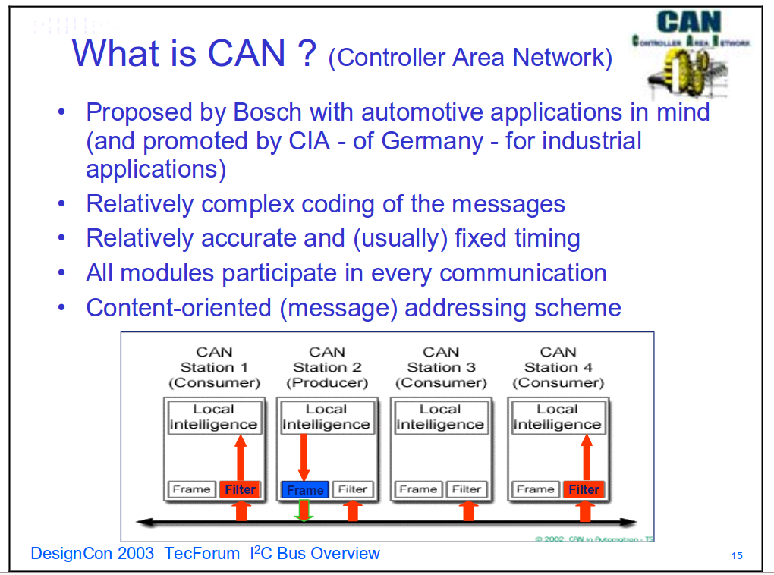
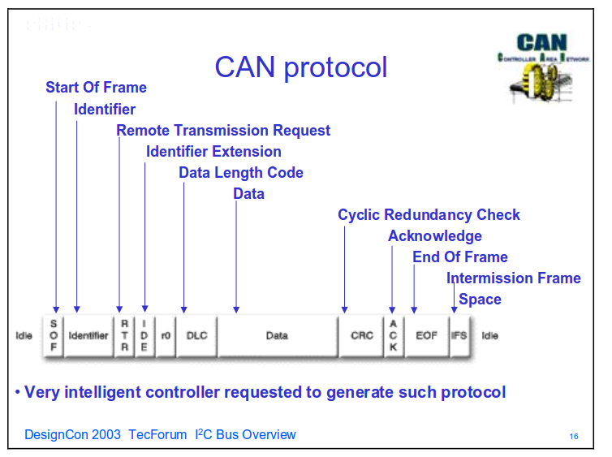
can
1
Notes:
1

Slide 45
USB接口的数据线采用差分布线的方式，以保证信号传输的质量，抑制干扰。通常认为信号在传输时采用3种方式：单点对单点、差分模式和共模模式。相比于单点对单点模式，差分信号有着明显的不足，就是它需要两根走线，如果PCB上信号都采用差分布线的方式，可以想象电路设计者会陷入绝境。但是差分信号又有着其不可替代的优点[3]：
（1）差分信号在低电平应用时非常有效。因为如果一个信号的电平非常低，那么这个信号就比较容易受到其他信号的干扰，而差分信号使这个信号的电平加倍。
（2）由于差分信号是电平相同而且反向的两根信号，不需要参考平面作为信号回路，这样就不需要地平面或电源平面的连续性和完整性。
（3）如果两根信号都存在噪声干扰，就可以通过相减来抵消噪声，因此差分信号对信号干扰有着天然的免疫力。
（4）相对于单点信号，差分信号的开关时序会比较精确，因为单点信号受到噪声干扰后时序或占空比通常会发生变化。
usb
1
Notes:
1

Slide 46
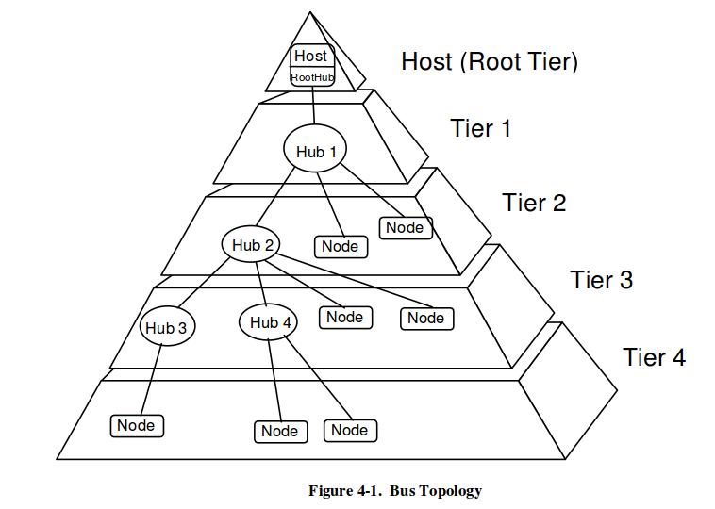
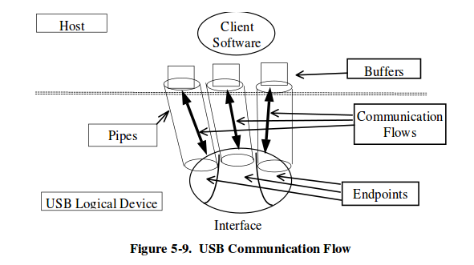
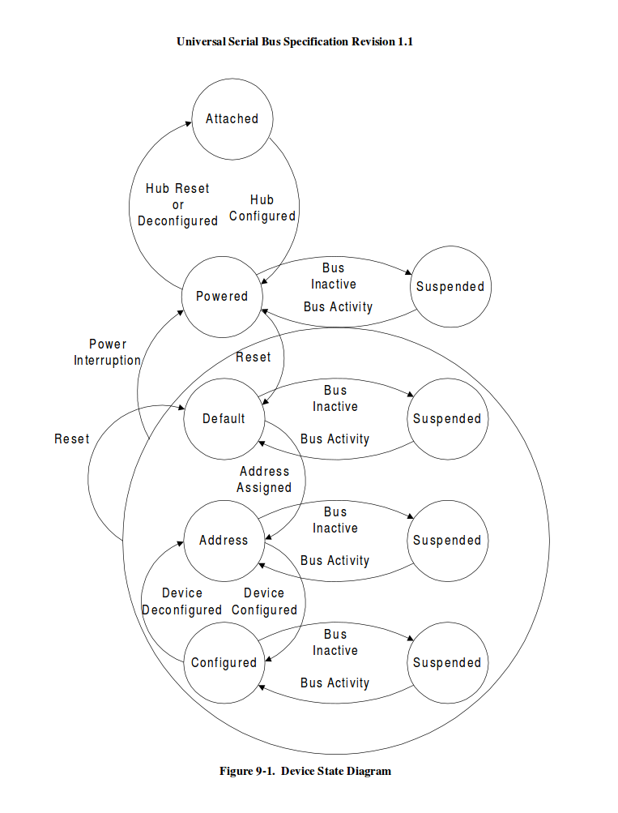
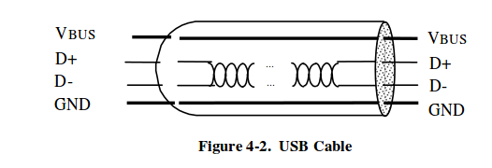
usb
1
Notes:
1

Slide 47
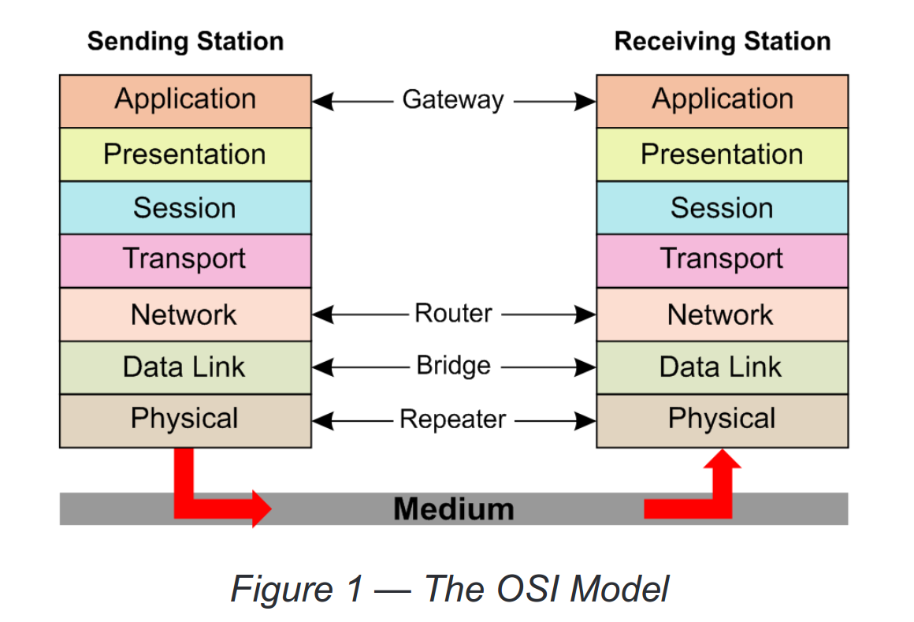
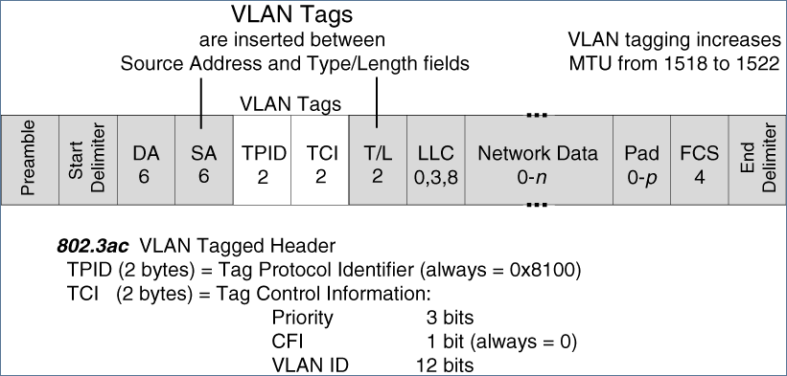
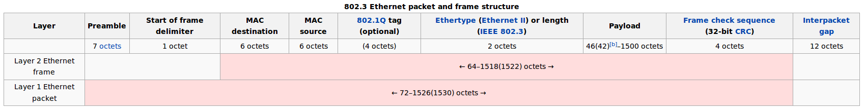
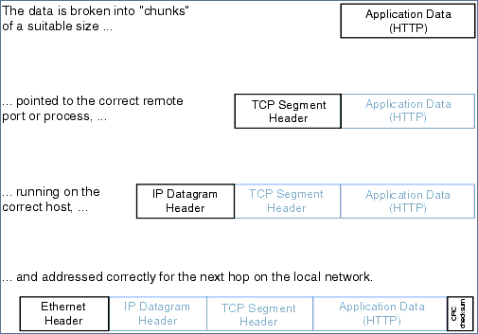
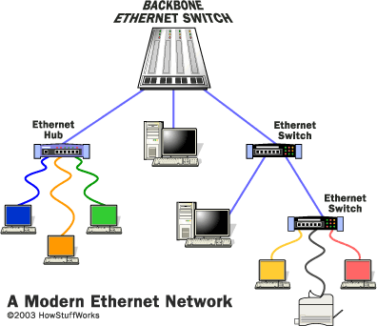
ethernet
Ethernet (IEEE 802.3)
1
交换式以太网
Notes:
1

Slide 48
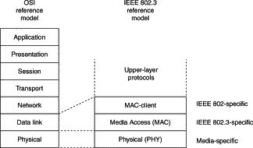
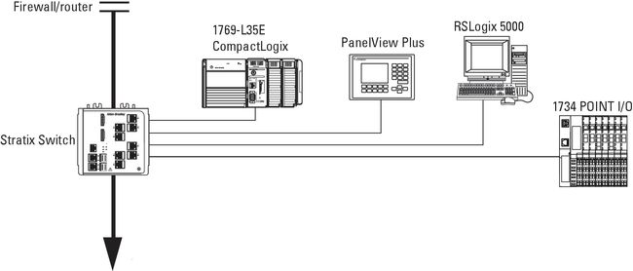
HW Components related to HostIF
EtherNet/IP Typical Configurations
Star Topology

Slide 49
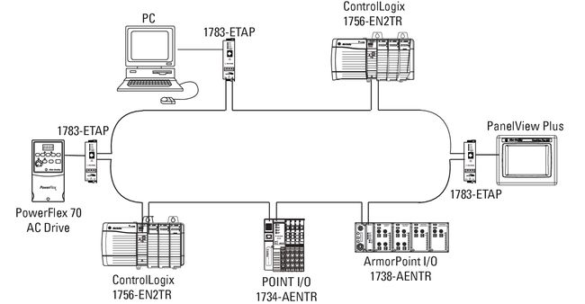
HW Components related to HostIF
EtherNet/IP Typical Configurations
ring Topology

Slide 50
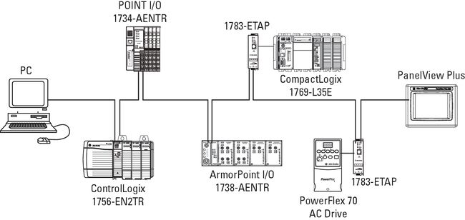
HW Components related to HostIF
EtherNet/IP Typical Configurations
linear Topology

Slide 51
raw
search
Note draw
Find law
Paper pencil
web
ppt
Host I/F
(SPI)
Could fix
improve
book
Sensors eys ears
brain
Git historycal
Save log data
Save log data
eye
Flash
github
Distribute store
Spritzer Standalone system
Spritzer Standalone system

Slide 52
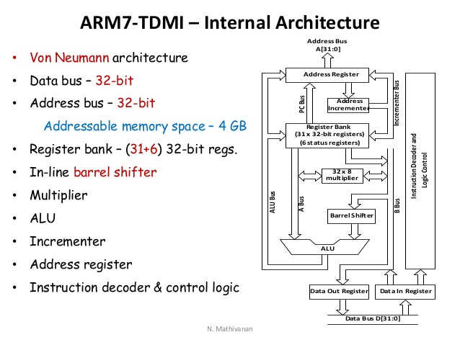
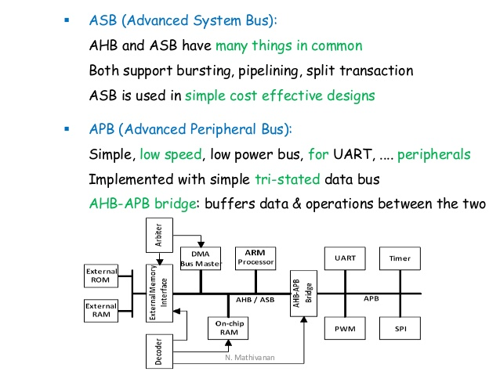
HW Components related to HostIF
Cpu mmu

Slide 53
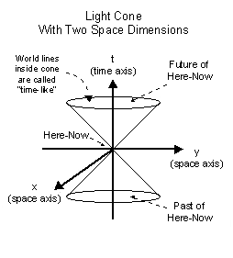
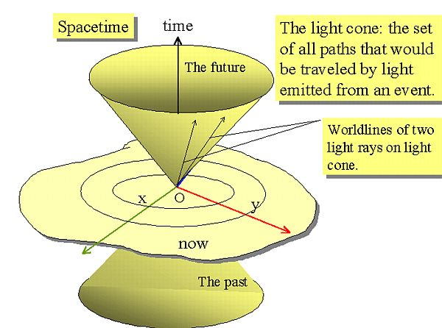
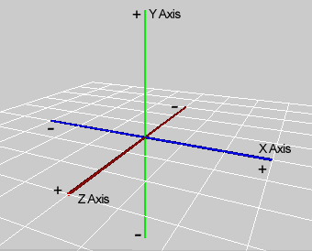
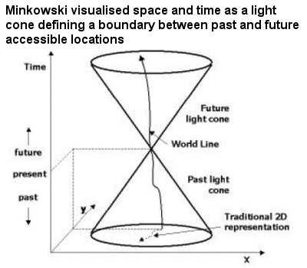
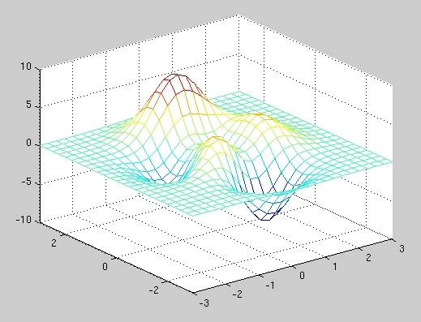
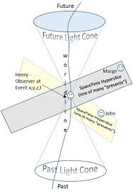
WORD
prefix
root
suffix
F ,func, force
x
F ,func, force
Y
Z
Sentence
paragraph
artical
1, See:
2, Voice read:

Slide 54



Picture & abstraction
Math
LOGO
My campany
My lab library website
Nature and tree
Moon stars
Cayenne
Yosemite
Reese
Ranger
Cruise
Endurence
Jack
name
Achillies
Addams
adrian
Ava addams
Julie kelly orielly
Nathan adrian

Slide 55
Bluetooth LE single Mode
Bluetooth LE single Mode
General
Attribute
Profile
socket
Attribute
Protocol
Attribute
Protocol
L2CAP
sk_buff
Link
layer
Link
layer
Low energy
RF
Low energy
RF

Slide 56
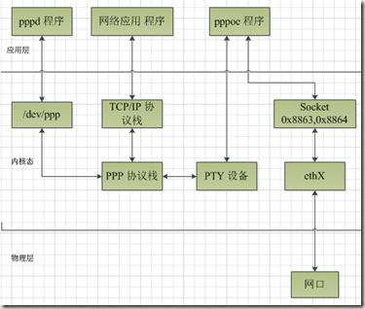
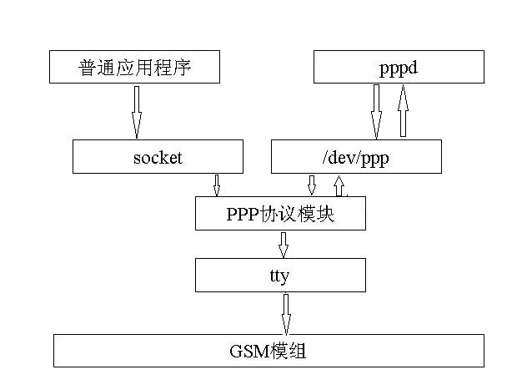
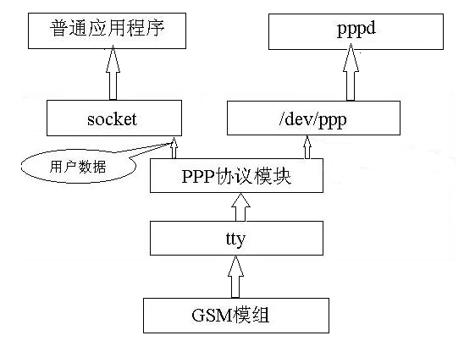
Linux PPP详细介绍
http://blog.csdn.net/jmq_0000/article/details/7105287
PPP 3G

Slide 57
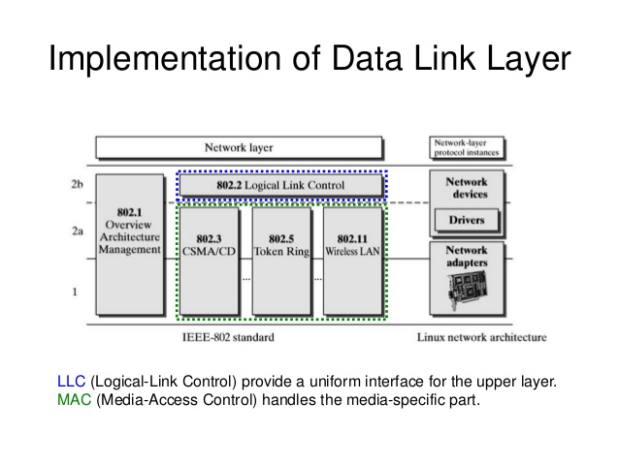
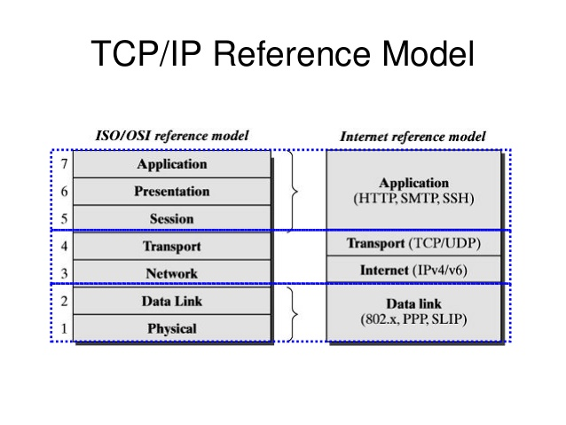
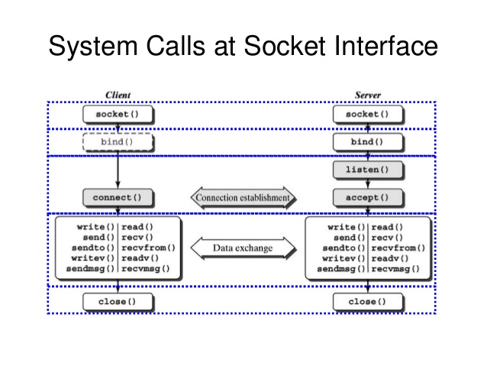
http://www.slideshare.net/hugolu/the-linux-networking-architecture
Network driver architecture

Slide 58
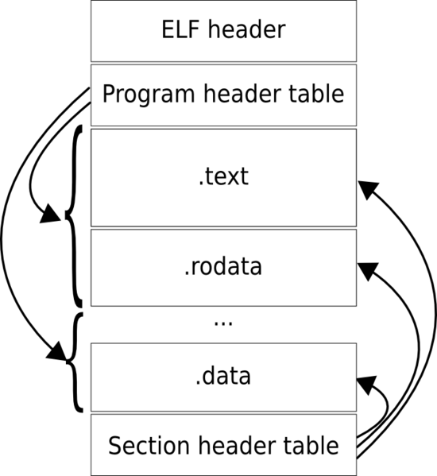

Slide 59
y=f(x)
f
x
Y
Stash : list show apply
Add +
Sub-
Change
find
+-*/

Slide 60
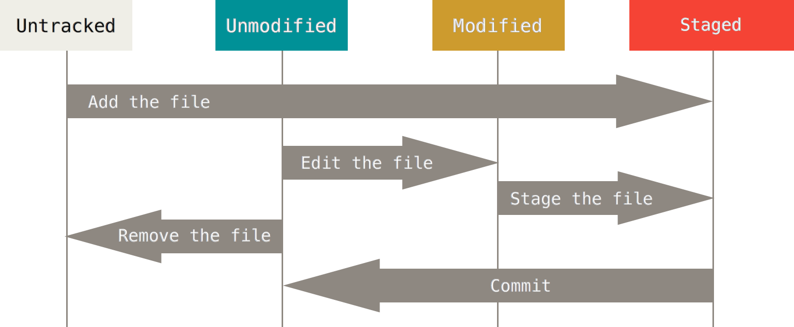
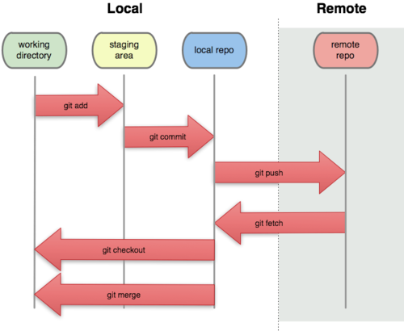
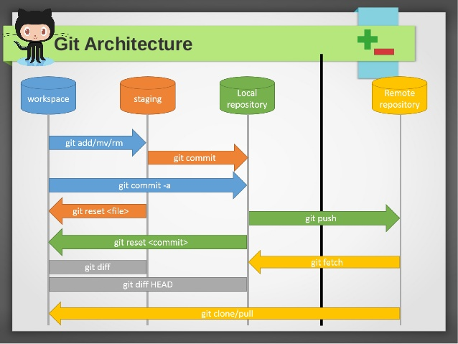
git
Attribute
commits
Head
Fetch head
repository
Git cmd
/bin/git
Checkout
Stash : list show apply

Slide 61
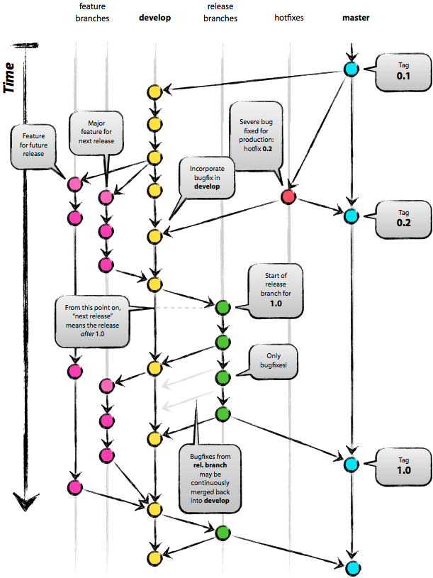
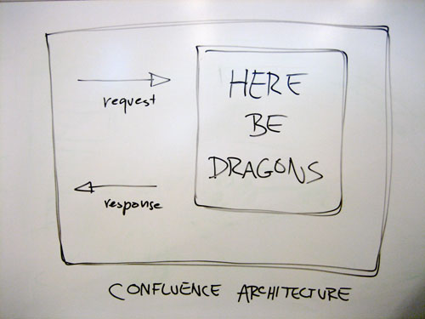
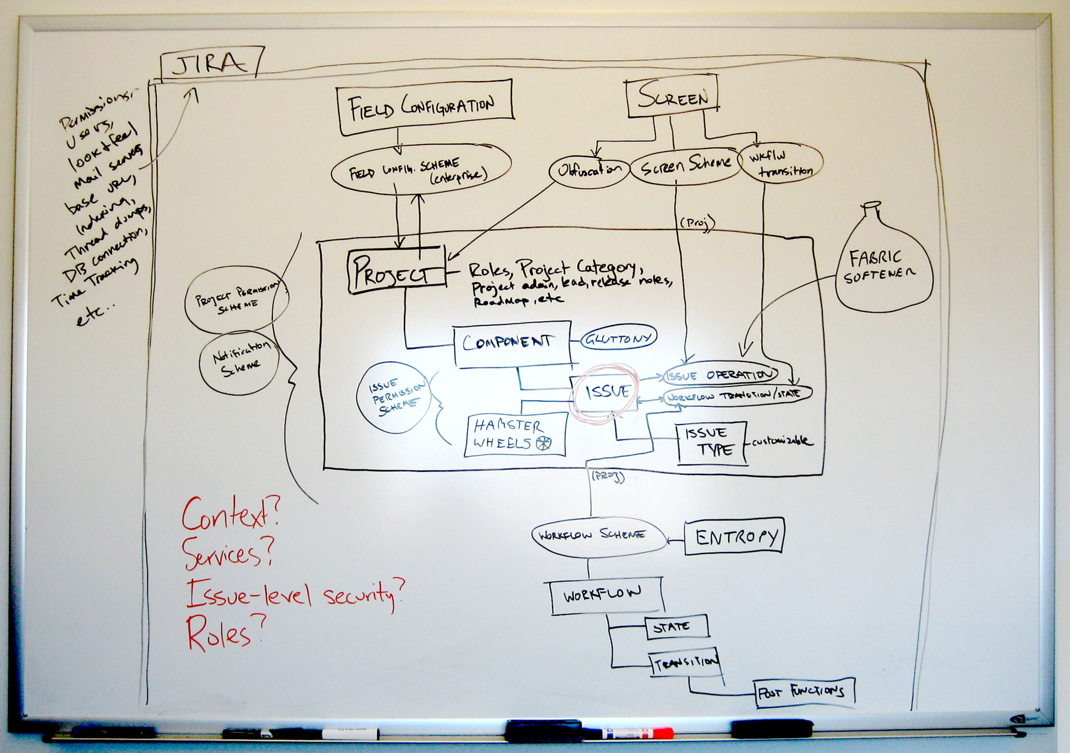

Slide 62
bus
pci
Serial
paralel
uart
usb
Spi/iic
rs232
I-wire
BUTTON_CHANGE
Pci-e
clock
Spi/iic
Sync
async
uart
usb

Slide 63


Slide 64


Slide 65


Slide 66


Slide 67


Slide 68


Slide 69

Vfs
Task file
inode
Chenlijun

Slide 70
ldd3 p169
应用程序
很固定的三步
fcntl(fd, F_SETOWN, getpid());//指定一个文件为属主，与驱动程序联系起来
Oflags = fcntl(fd, F_GETFL); //取得open时代文件标志符
fcntl(fd, F_SETFL, Oflags | FASYNC); //每当FASYNC标志状态改变时，linux设备驱动程序中的fasync()函数将得以执行。
当然还有一步
signal(SIGIO, my_signal_fun);//底层驱动发上来SIGIO的信号，然后调用my_signal_fun
驱动程序
1.定义一个fasync_struct 类型的变量
2.在fops中增加要使用的函数.fasync = xxx_fasync
3.实现这个函数
4.调用fasync_helper进行初始化
return fasync_helper (fd, filp, on, &button_async);
（往往就作为第三步的返回值）
5.在需要发信号的地方使用
kill_fasync (&button_async, SIGIO, POLL_IN);
/*将button_async，发一个SIGIO信号，告诉设备可读*/
6.在release中
从异步通知列表中删除该flip
fasync(-1,filp,0)

Slide 71



Elf

Slide 72
accounte
Esprit
Zhengda: 50493688
Outlet:58836073
51509610
POP top english
Victorious wang ./ zhige
http://43.82.125.6/redmine/l
jie.chen
Abcd1234
Pactera
http://hub.pactera.com/?q=home-page
P0072938
Ee

Slide 73
Makefile
顶层 Makefile
.config
内核配置文件
arch/$(ARCH)/Makefile
具体架构的 Makefile
scripts/Makefile.*
通用的规则等。面向所有的 Kbuild Makefiles。
kbuild Makefiles
内核源代码中大约有 500 个这样的文件
Kernel build systemn
make
vmlinux
image
.config
bzImage
Makefile
modules
Kbuild
menuconfig

Slide 74
Bluetooth LE single Mode
Internet of Things
socket
Attribute
Protocol
sk_buff
6LoWPAN
Bluttooth low energy IPv6 over Low-Power Wireless Personal Area Networks
Internet Protocal Support Profile
IPSP

Slide 75
sk_buff
Alloc
Free
Put
push
bus
Open
Read/recv
Write/send
driver
layers
device
Net driver
scheduler
socket
platform
Socket buffer
bus
sk_buff
probe
ARP
IP
wait_queue
device
driver
sk_buff
dev_queue_xmit
net_device
Reg
Unreg
net_reg
netif_rx
Task queue
net_device
Interrupt
Task
Lsit, net core struct
Kernel process
thread
context
context
add
net_dev_ops
xxx
Recv:1. Interrupt
2.polling
Send
Recv
Status
ioctl
hard_start_xmit
NET_RX_SOFTIRQ
xx_interrupt
xx_rx
xxx_ops
schedule_delayed_work
dm9000_start_xmit

Slide 76

Debug stub in the kernel compliant with gdbremote protocol
KGDB and GDB

Slide 77

Debug stub in the kernel compliant with gdbremote protocol
b. Qemu and gdbserver

Slide 78

Debug stub in the kernel compliant with gdbremote protocol
gdbremote compliant JTAG - e.g. OpenOCD

Slide 79
#define VERMAGIC_STRING \
29 UTS_RELEASE " " \
30 MODULE_VERMAGIC_SMP MODULE_VERMAGIC_PREEMPT \
31 MODULE_VERMAGIC_MODULE_UNLOAD MODULE_VERMAGIC_MODVERSIONS \
32 MODULE_ARCH_VERMAGIC
b. Qemu and gdbserver
Insmod:
nvalid module format
Dmesg | tail
rtutil3070ap:version magic '2.6.35.14-96.fc14.i686 SMP mod_unload 686 ' should be '2.6.35.6-45.fc14.i686 SMP mod_unload 686'
version magic
Module Makefile
/lib/modules/`uname -r`/build
Ls build(soft link)
#define VERMAGIC_STRING \
"2.6.35.6-45.fc14.i686" "" \
MODULE_VERMAGIC_SMP MODULE_VERMAGIC_PREEMPT \
MODULE_VERMAGIC_MODULE_UNLOAD MODULE_VERMAGIC_MODVERSIONS \
MODULE_ARCH_VERMAGIC

Slide 80


Slide 81
Instructions
Process steps capslate:
functions
Computer whole
f
RAM
data
OP+data
+-*/
Algorithm
Objects/ struct
data+functions
Layers
Don’t call me, I call you
OP+data
Binary
num
ALU
binary
&
|
^
schudler
GDB, ld, make
Add
Sub
MULti
jump
Task 0, init , kthreadd
Vim, git ppt
PUSH
SP
IP
app
POP
CALL
Eax ebx
Context switch
Sys call
ret
sk_buff
reti
Von neamman machine
instructions
Interrupt context switch
kernel
Functional
programming

Slide 82
interrupt
Synchron
exceptions
request
Async
Interrupt
hardware
Status reg
RAM
data
ALU
OP+data
Routine
do_irq
Jump
PUSH
POP
CALL
RETI
SP
IP
Eax ebx
Top half
Tasklet
Botton half
Work queue
kthread

Slide 83
Make vmlinux
Synchron
exceptions
request
Async
Interrupt
hardware
Status reg
RAM
data
ALU
OP+data
Routine
do_irq
Jump
PUSH
POP
CALL
RETI
SP
IP
Eax ebx
Top half
Tasklet
Botton half
Work queue
kthread

Slide 84
Load image
bootcmd
address
RAM
data
stack
env
heap
vmlinux
ALU
mmu
data
Ethernet
Nfs tftp
Bus
Sd
Nand falsh
text
SP
IP
uboot
Step stone
Eax ebx
kernel
fs
sdram

Slide 85
Execute image
Synchron
exceptions
request
Async
Interrupt
hardware
Status reg
RAM
data
ALU
OP+data
Routine
do_irq
Jump
PUSH
POP
CALL
RETI
SP
IP
Eax ebx
Top half
Tasklet
Botton half
Work queue
kthread

Slide 86
git
master
Git.mycompany.com
commit
commit
commit
clone
HEAD
fetch
Remote add
pull
push
origin/master
Checkout/rm
Work directory
stage
.git dir
commit
commit
commit
add
comit
Git core
merge
commit
commit
.git dir
commit
Branch
stash
tree
blob
master

